Slide 1
Hopes for and reality behind pension funds
Ania Zalewska
Centre for Governance and Regulation
School of Management, University of Bath, UK
“Savings, Risks and Retirement Financing”
Institut du Risque et de l’Assurance du Mans (IRA), Le Mans Université
20 March 2018

Slide 2
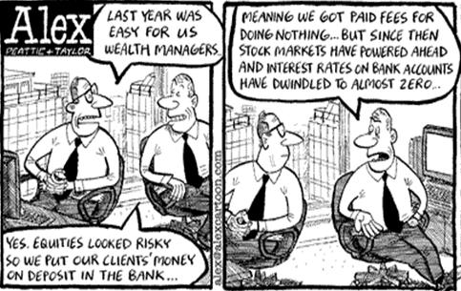
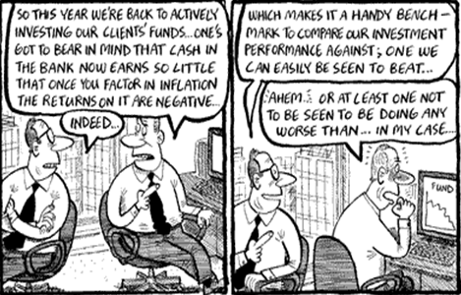

Slide 3
How do they prioritise?
vs.
Most important issues
 | Rank
Strategy | 1
Financial performance | 2
Leadership - Chairman/CEO | 3
Capital allocation | 4
Executive remuneration | 5
Composition (incl. diversity) of the board | 6
Environment | 7
Culture | 8
Audit and reporting | 9
Pay and conditions of (non-exec) employees, incl. health and safety | 10
Human rights | 11
Competition | 12
Most frequently addressed issues
 | Rank
Strategy | 1
Executive remuneration | 2
Financial performance | 3
Leadership - Chairman/CEO | 4
Capital allocation | 5
Composition (incl. diversity) of the board | 6
Environment | 7
Audit and reporting | 8
Competition | 9
Pay and conditions of (non-exec) employees, incl. health and safety | 10
Human rights | 11
Culture | 12

Slide 4
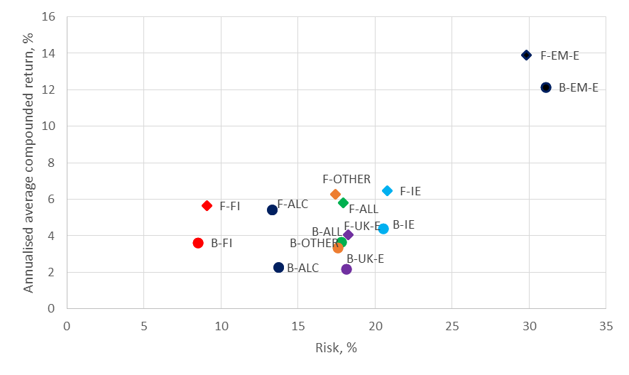
Risk-return characteristics

Slide 5
Risk-return characteristics

Slide 6
How to beat the benchmark?
return
P
M
PPB
risk

