Slide 1

Saving with group or individual personal pension schemes.
Ania Zalewska
Centre for Governance and Regulation
School of Management, University of Bath, UK
“Savings, Risks and Retirement Financing”
Institut du Risque et de l’Assurance du Mans (IRA), Le Mans Université
20 March 2018

Slide 2
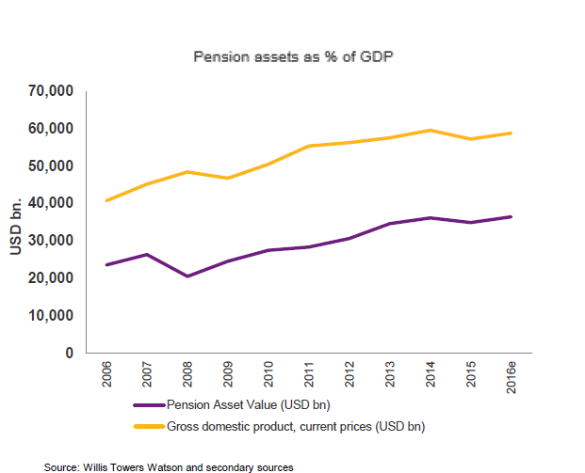
Basic facts
Size of the pension industry
  Wills Towers Watson’s ‘Global Pension Assets Study 2017’ in 2016:
  $36,435 billion in pension assets (62.0% of their GDP) in 22 major pension markets, of which:
    Australia – $1,583 bn or 126%
    Canada - $1,575 bn or 103%
    Japan - $2,808 bn or 59%
    Netherlands - $1,296 bn or 168%
    Switzerland - $817 bn or 123%
    UK - $2,868 bn or 108%
    USA - $22,480 bn or 121%
Notes:
$224 trillion underfunding by 2050 , study the World Economic Forum; this figure incorporates, corporate, public and individual pensions

Slide 3
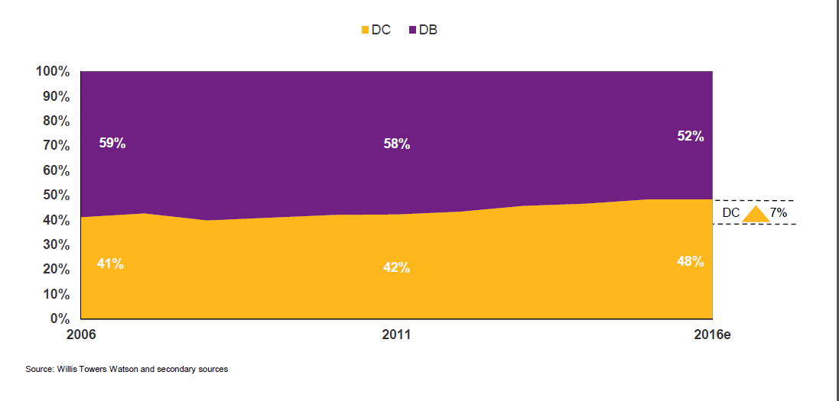
Basic facts
Steady decline of the DB schemes/ Steady growth of the DC schemes

Slide 4
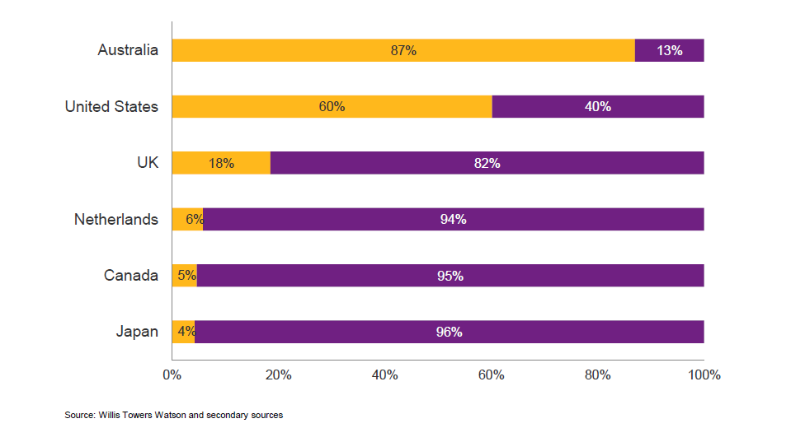
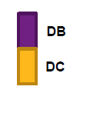

Slide 5
DB schemes
 | # not flagged companies | # flagged companies | % | Underfunding of not flagged companies | Underfunding of flagged companies
US | 552 | 149 | 21% | 6.7% | 23.8%
UK | 63 | 39 | 38% | 3.0% | 15.6%
Switzerland | 18 | 9 | 33% | 3.9% | 12.9%
NL | 24 | 6 | 20% | 2.9% | 10.1%
Japan | 2227 | 571 | 20% | 2.2% | 9.7%
Canada | 141 | 18 | 11% | 4.6% | 17.2%
Australia | 17 | 1 | 6% | 0.7% | 7.6%
Source: MSCI Accounting and Governance Risk (AGR), September 2016

Slide 7
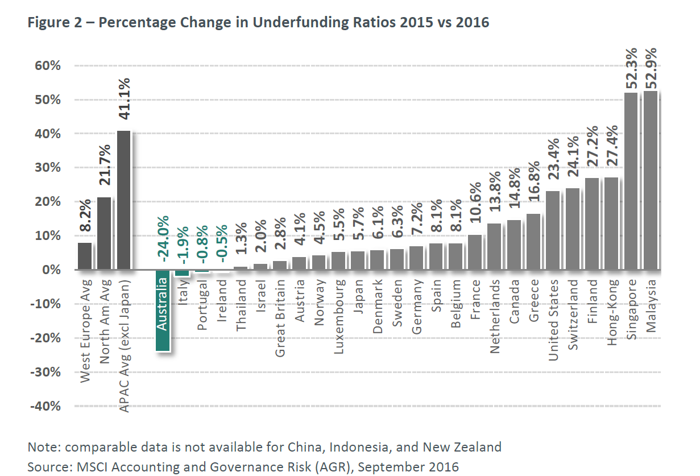

Notes:
From: MSCI, GLOBAL PENSION UNDERFUNDING CONCERNS | OCTOBER 2016

Slide 8
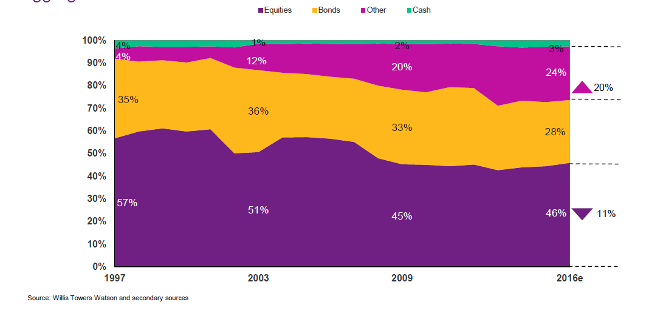
‘De-risking’- ‘de-equitization’

Slide 9
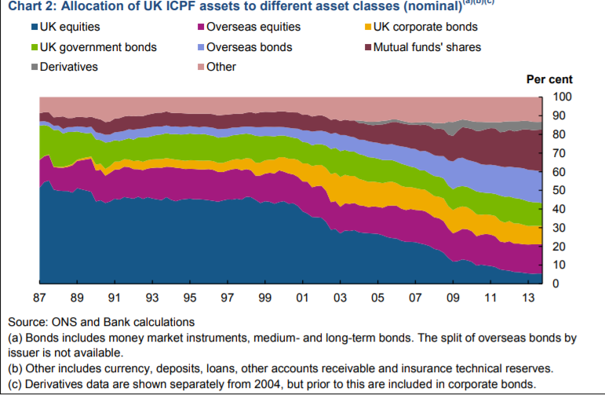
Source: Procyclicality and structural trends in investment allocation by insurance companies and pension funds, BoE

Slide 10
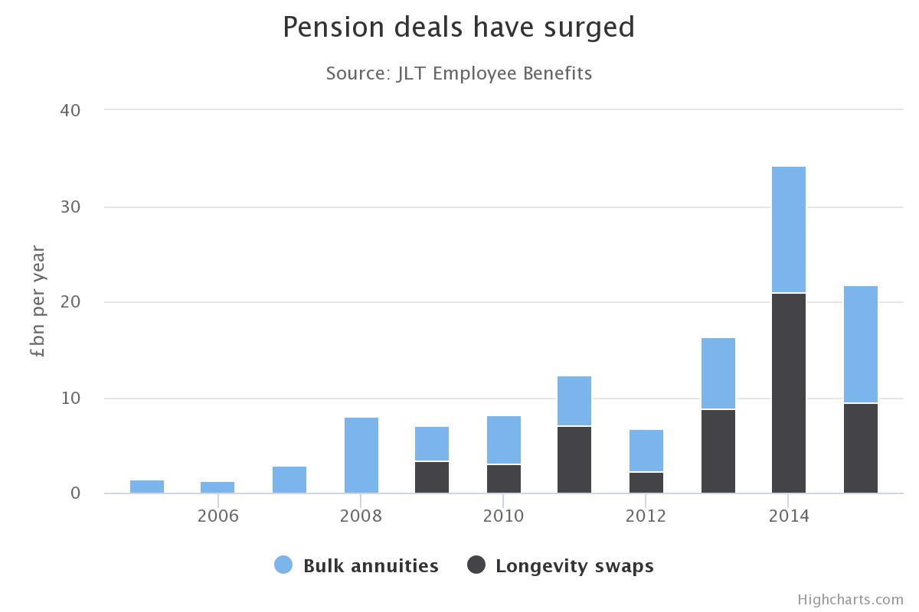
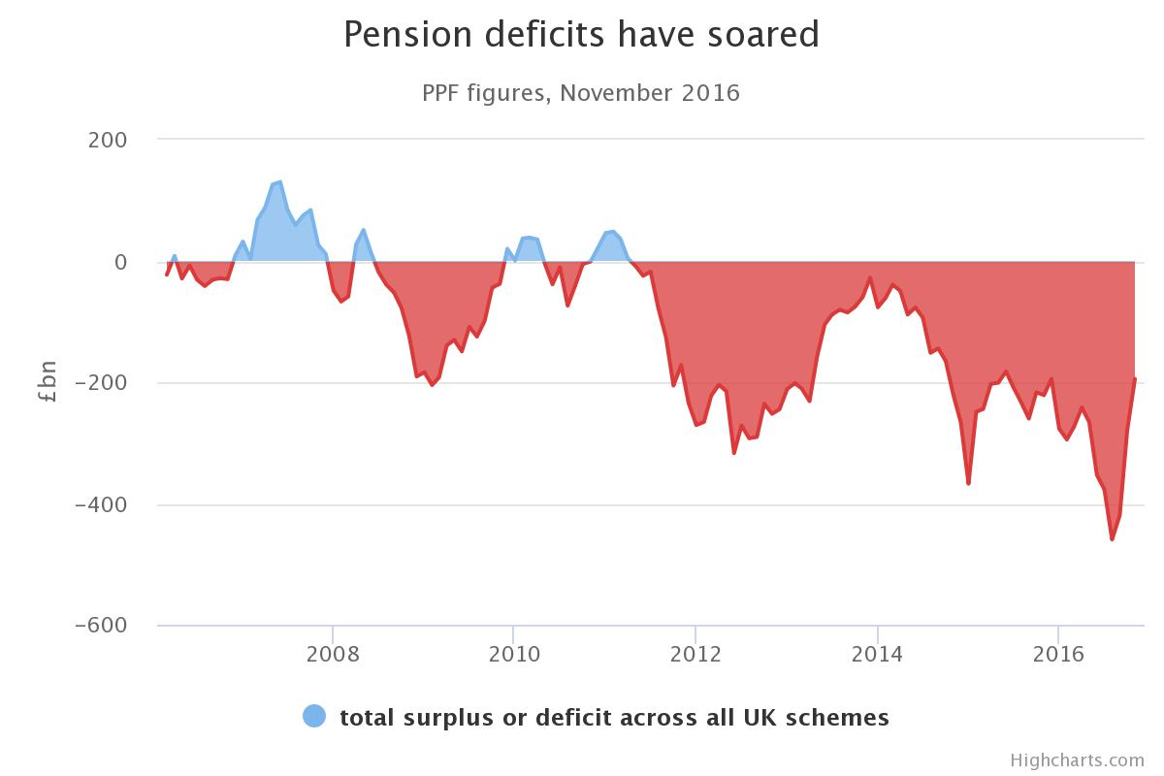
‘De-risking’ - continued
Liability-driven-investments (LDIs)
Buy-in/outs
Notes:
From: Pensions buyouts are booming for overburdened companies, The Telegraph, dec 2016
https://www.telegraph.co.uk/business/2016/12/30/pensions-buyouts-booming-overburdened-companies/

Slide 11
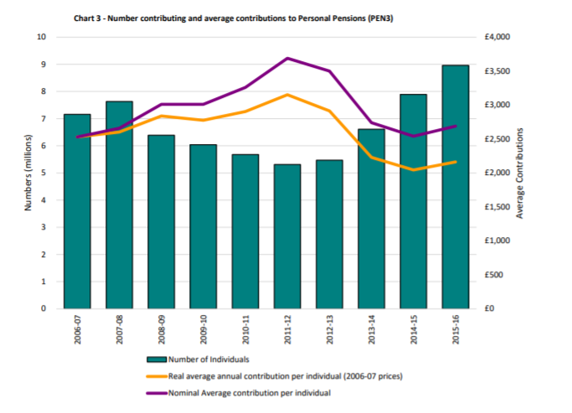
Are DC schemes the meaningful alternative?
People are resistant to save
  delay the decision
  Do not save enough
(Rae 1834, Pigou 1920, Ramsey 1928,
Strotz 1955, Phelps and Pollak 1968)
Participation in capital markets
is IQ related
(Bernheim 1995, 1998, Cole, Paulson and Shastry 2014,
Grinblatt Keloharju and Linnainmaa 2011, Mandell 2004,
Guiso and Jappelli 2005, Lusardi and Mitchell 2006,
Moore 2003, van Rooij, Alessie, and Lusardi 2011)
Mr & Mrs Average have lower investment skills than professional investors
Ahmed, Barber and Odean 2016, Beshears, Choi, Laibson, and Madrian 2009, Campbell 2006, Gennaioli, Shleifer, and Vishny 2015, Guiso and Viviano 2015, van Rooij, Alessie, Lusardi 2011, von Gaudecker 2015)

Slide 12
Yet…
Institutional investors are not that skilled either (Jensen 1968, Gruber 1996, French 2008, Bergstresser, Chalmers, and Tufano 2009, Del Guercio, Reuter and Tkac 2010, Chalmers and Reuter 2012, Hackethal, Haliassos and Jappelli 2012)
Institutional investors discriminate against less informed, more dispersed, in other words, “more vulnerable” investors
  Banks (Beck and Brown 2015, Cavalluzzo, Cavalluzzo and Wolken 2002, Collin and Baker 2005), Palia 2016)
  Mutual funds (Christoffersen and Musto, 2002; Houge and Wellman, 2007; Gil-Bazo and Ruiz-Versy, 2009; Shirley and Stark, 2016)
  Pension funds?

Slide 13

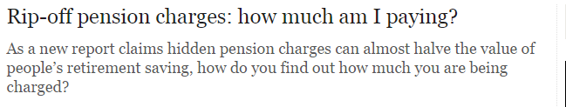
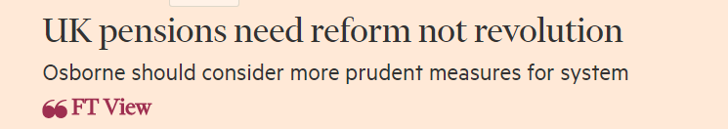
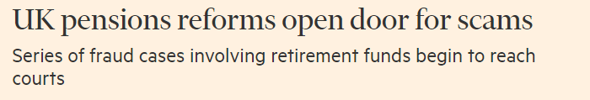
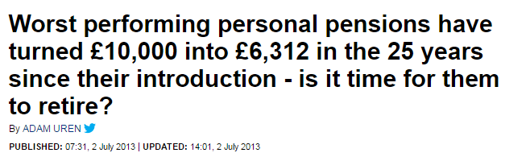

Slide 14
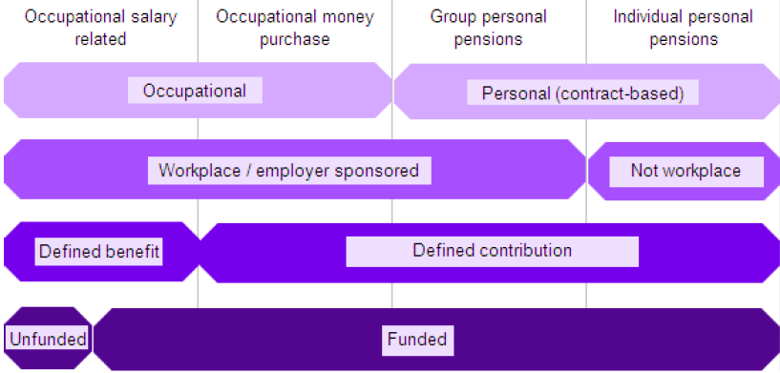
UK pension industry

Slide 15
Does it make a difference whether one saves with group or individual schemes?
Companies may have a greater bargaining power
  Costly exit
  Reputation
  Bigger contracts
    Economies of scale
      Lower fees
      More flexible contracts
Companies may have better monitoring
    Better returns
Individuals have less financial understanding
    Better performance targets

Slide 16
What can we expect?
H1: GPP funds outperform IPP funds
H2: IPPs’ PPBs are not tougher than GPPs’ PPBs
H3: GPPs’ PPB-related performance my not be better than IPP’s PPB-related performance

Slide 17
Sample
1980-2015 available data
Adopted characteristics
  1963-2014 inception
  1986-2015 returns
Periods considered
  January 1986 – December 2015: 12K IPPs v.1.4K GPPs
  January 1996 – December 2015: 12KIPPs v. 1.4 GPPs
  August 2007 – December 2015: 14K IPPs v. 1.8K GPPs
Analysis
  Cross-section
  Time series
  Propensity score matching

Slide 18
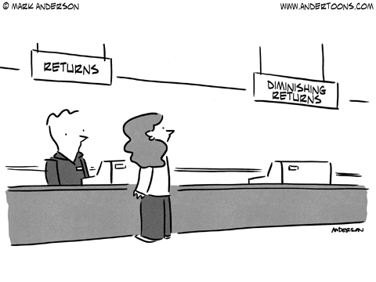
Who gets better returns (H1)?

Slide 19
Who earns higher returns (H1)?
GPPs statistically significantly outperform IPPs
  Whole sample
  Sample restricted to funds with PPBs
  Sample restricted to funds by providers who offer both IPPs and GPPs
  Sample restricted to funds by providers who offer both IPPs and GPPS and have the same PPBs
There is no statistical difference between the performance of IPPs provided by providers who offer IPPs only and offer both IPPs and GPPs
There is no statistical difference between the performance of GPPs provided by providers who offer GPPs only and offer both IPPs and GPPs

Slide 20
Who gets better returns (H1)?
There are differences in the performance across different fund asset classes considered:
  Equity IPPs < Equity GPPs
  Money market IPPs < Money market GPPs
  Allocation IPPS < Allocation GPPs
  Alternative IPPs < Alternative GPPs
  Property IPPs < Property GPPs
  No difference for fixed income and miscellaneous
This is robust to different sample specifications
These differences are not explained by differences in downside risk – if anything, GPPs have lower downside risk than IPPs
7-factors alphas are statistically significantly higher for the equity, mixed (alternative), property and money market sectors plus several investment styles within fixed interest

Slide 21

Who has tougher benchmarks (H2)?

Slide 22
Reported D_{GPP}
 | R_{PPB}-R_{TB} |  |  |  |  |  | Sharpe_{PPB}
 | 1986-2015 |  | 1996-2015 |  | 2007-2015 |  | 1986-2015 |  | 1996-2015 |  | 2007-2015
Equity | 0.361 |  | 0.369 |  | 0.172 |  | 0.036* |  | 0.037** |  | -0.032
 | (0.287) |  | (0.270) |  | (0.522) |  | (0.054) |  | (0.040) |  | (0.609)
Fixed income | 0.112 |  | 0.094 |  | 0.548* |  | -0.063 |  | -0.068 |  | -0.033
 | (0.675) |  | (0.721) |  | (0.061) |  | (0.256) |  | (0.219) |  | (0.480)
Money Market | 0.079 |  | 0.092 |  | 0.004 |  | 0.028 |  | 0.056** |  | 0.048*
 | (0.198) |  | (0.171) |  | (0.919) |  | (0.313) |  | (0.048) |  | (0.075)
Allocation | 3.633*** |  | 3.631*** |  | 3.840*** |  | -0.037 |  | -0.037 |  | -0.016
 | (0.000) |  | (0.000) |  | (0.000) |  | (0.709) |  | (0.708) |  | (0.880)
Alternative | -0.059 |  | -0.059 |  | -0.020 |  | -0.350 |  | -0.350 |  | -0.348
 | (0.865) |  | (0.865) |  | (0.950) |  | (0.783) |  | (0.783) |  | (0.787)
Miscellaneous | -0.569 |  | -0.530 |  | 0.795 |  | 1.052 |  | 1.054 |  | 1.309
 | (0.548) |  | (0.577) |  | (0.493) |  | (0.137) |  | (0.136) |  | (0.102)
Property | 0.503** |  | 0.887** |  | 0.453 |  | 0.116** |  | 0.219*** |  | 0.079
 | (0.046) |  | (0.013) |  | (0.228) |  | (0.015) |  | (0.003) |  | (0.213)

Slide 23
Average treatment effects on treated (ATET)
Matched by: External/Internal, ABI PC, Age
ATET | 0.455** |  | 0.241 |  | 0.451** |  | 0.199*** |  | 0.084* |  | 0.150***
 | (0.040) |  | (0.218) |  | (0.011) |  | (0.000) |  | (0.089) |  | (0.001)
N | 1,958 |  | 1,962 |  | 2,240 |  | 1,958 |  | 1,962 |  | 2,240
Matched by: External/Internal, ABI PC, Age, Size
ATET | 0.248 |  | 0.733*** |  | 0.492** |  | 0.138** |  | 0.164*** |  | 0.125**
 | (0.346) |  | (0.002) |  | (0.031) |  | (0.017) |  | (0.001) |  | (0.026)
N | 1,238 |  | 1,242 |  | 1,430 |  | 1,238 |  | 1,242 |  | 1,430

Slide 24
Who has tougher benchmarks (H2)?
IPPs do not have tougher benchmarks
Some evidence that equity, money market and property GGP funds have more challenging benchmarks

Slide 25
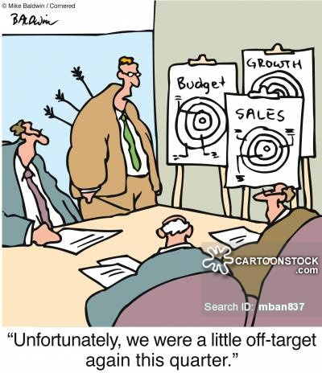
Who has better PPB-related performance (H3)?

Slide 26
Reported D_{GPP}
 | R-R_{PPB} |  |  |  |  |  | M²
 | 1986-2015 |  | 1996-2015 |  | 2007-2015 |  | 1986-2015 |  | 1996-2015 |  | 2007-2015
Equity | 1.022*** |  | 1.039*** |  | 1.232*** |  | 0.896*** |  | 0.916*** |  | 1.109***
 | (0.001) |  | (0.000) |  | (0.000) |  | (0.001) |  | (0.001) |  | (0.000)
Fixed income | 0.053 |  | 0.094 |  | 0.408 |  | 0.132 |  | 0.175 |  | 0.427*
 | (0.748) |  | (0.552) |  | (0.176) |  | (0.376) |  | (0.247) |  | (0.069)
Money Market | 0.331 |  | 0.318 |  | 0.514** |  | 0.293* |  | 0.277 |  | 0.390*
 | (0.109) |  | (0.235) |  | (0.025) |  | (0.059) |  | (0.260) |  | (0.098)
Allocation | -1.924*** |  | -1.924*** |  | -1.539*** |  | -0.984*** |  | -0.983*** |  | -0.355**
 | (0.000) |  | (0.000) |  | (0.010) |  | (0.000) |  | (0.000) |  | (0.045)
Alternative | 3.417*** |  | 3.417*** |  | 3.417*** |  | -0.163 |  | -0.163 |  | -0.227
 | (0.001) |  | (0.001) |  | (0.001) |  | (0.295) |  | (0.295) |  | (0.158)
Miscellaneous | 0.155 |  | 0.061 |  | 0.638 |  | -0.151 |  | -0.234 |  | 0.296
 | (0.914) |  | (0.966) |  | (0.614) |  | (0.905) |  | (0.854) |  | (0.797)
Property | 0.905*** |  | 1.177*** |  | 1.900*** |  | 0.818*** |  | 1.758*** |  | 2.258***
 | (0.001) |  | (0.001) |  | (0.001) |  | (0.000) |  | (0.000) |  | (0.000)

Slide 27
Matched by: External/Internal, ABI PC, Age R-R_{PPB} M²
ATET |  | 0.859*** |  | 0.671*** |  | 1.056*** |  | 0.447*** |  | 0.805*** |  | 0.749***
 |  | (0.000) |  | (0.000) |  | (0.000) |  | (0.000) |  | (0.000) |  | (0.000)
 |  | 1,958 |  | 1,962 |  | 2,240 |  | 1.958 |  | 1,962 |  | 2,240
Matched by: External/Internal, ABI PC, Age, Size
ATET |  | 0.497*** |  | 0.718*** |  | 1.047*** |  | 0.334** |  | 0.560*** |  | 0.810***
 |  | (0.004) |  | (0.002) |  | (0.000) |  | (0.031) |  | (0.005) |  | (0.000)
 |  | 1,238 |  | 1,242 |  | 1,430 |  | 1,958 |  | 1,962 |  | 2,240

Slide 28
 | GIR |  |  |  |  |  | Tracking error
 | 1986-2015 |  | 1996-2015 |  | 2007-2015 |  | 1986-2015 |  | 1996-2015 |  | 2007-2015
Equity | 0.041*** |  | 0.042*** |  | 0.058*** |  | -1.289*** |  | -1.255*** |  | -1.080***
 | (0.008) |  | (0.007) |  | (0.000) |  | (0.000) |  | (0.001) |  | (0.003)
Fixed income | -0.002 |  | 0.002 |  | 0.038 |  | -0.182 |  | -0.181 |  | -0.513
 | (0.872) |  | (0.892) |  | (0.101) |  | (0.497) |  | (0.502) |  | (0.266)
Money Market | 0.264*** |  | 0.272*** |  | 0.399*** |  | -0.255 |  | -0.247 |  | -0.597*
 | (0.008) |  | (0.003) |  | (0.008) |  | (0.365) |  | (0.288) |  | (0.051)
Allocation | -0.060*** |  | -0.060*** |  | -0.025** |  | 1.215*** |  | 1.222*** |  | 1.947***
 | (0.001) |  | (0.001) |  | (0.048) |  | (0.009) |  | (0.010) |  | (0.000)
Alternative | 0.380** |  | 0.380** |  | 0.369*** |  | -0.037 |  | -0.037 |  | -0.040
 | (0.017) |  | (0.017) |  | (0.006) |  | (0.893) |  | (0.893) |  | (0.884)
Miscellaneous | -0.027 |  | -0.031 |  | 0.050 |  | -0.075 |  | -0.063 |  | 0.565
 | (0.774) |  | (0.747) |  | (0.664) |  | (0.949) |  | (0.957) |  | (0.639)
Property | 0.046*** |  | 0.077*** |  | 0.022* |  | -2.335*** |  | -2.632*** |  | -2.349***
 | (0.000) |  | (0.000) |  | (0.058) |  | (0.001) |  | (0.001) |  | (0.004)

Slide 29
Matched by: External/Internal, ABI PC, Age GIR Tracking error
ATET |  | 0.043*** | 0.043*** |  | 0.051*** | 0.051*** |  | 0.095*** | 0.095*** |  | -0.461*** | -0.461*** |  | -0.374** |  | -0.541***
 |  | (0.000) | (0.000) |  | (0.000) | (0.000) |  | (0.000) | (0.000) |  | (0.004) | (0.004) |  | (0.021) |  | (0.001)
 |  | 1,892 | 1,892 |  | 1,896 | 1,896 |  | 2,174 | 2,174 |  | 1,958 | 1,958 |  | 1,962 |  | 2,240
Matched by: External/Internal, ABI PC, Age, Size
ATET |  |  | 0.043** |  |  | 0.011 |  |  | 0.058*** |  |  | -1.062*** |  | -0.452** |  | -0.418*
 |  |  | (0.011) |  |  | (0.372) |  |  | (0.000) |  |  | (0.001) |  | (0.048) |  | (0.071)
 |  |  | 1,190 |  |  | 1,194 |  |  | 1,382 |  |  | 1,238 |  | 1,242 |  | 1,430

Slide 30
Who has better PPB-related performance (H3)?
GPPs that have more challenging PPBs also have better benchmark-related performance and have lower tracking errors
GPP allocation funds may be more equity- than bond-focused:
  Higher excess returns of GPPs, but no differences for Sharpe ratios
  Higher excess returns of GPP PPBs, but no differences for Sharpe ratios
  Underperformance of GPPs in relation to their PPBs

Slide 31

Summary and conclusions
GPPs earn higher excess returns than IPPs
GPPs have tougher PPBs than IPPs
GPPs perform better against the PPBs than IPPs
  Except for ASAM funds
GPPs have smaller tracking errors than IPPs
GPPs have smaller downside risk than IPPs
IPPs perform even worse when their PPBs are unclear

