Slide 1
Incentivising retirement savings: why and how?
Le Mans, 20 March 2018
Anne Lavigne
Secrétariat général du COR

Slide 2
Introduction
Context
Level and composition of savings (and wealth) in France
High level of household savings
High share of non financial savings (real estate)
High proportion of liquid and safe assets in the share of financial savings (life insurance)
PAYG pension system
High replacement rates
Fears of less generosity in the future (demography, rules of indexation of pensions, pension reform)
Why and how to give incentives to retirement savings?

Slide 3
Households savings in France
Composition of wealth
Non financial wealth (61%), financial (21%), professional (11%)
Holding rates of financial wealth
Financial assets (stocks and bonds, directly or indirectly): 24% in 2004 → 16.5% in 2015
Retirement savings (including life insurance): 37% in 2004 → 44% in 2015
Determinants of retirement savings: income, age (even over 70), education; self employed
25% of savers declare that they save mostly “to prepare for their old days”; higher for self-employed
3

Slide 4
What is the influence of the PAYG pension system on the households’ savings rate?
The French PAYG (observed and projected – COR 2017)
Public pension expenditures
Retirees vs active population
The crowding out debate
Assessment on French data (Blanchet et al., 2016)
Increase in PAYG pension wealth crowds out private wealth
Hard to estimate but the substitution mainly concerns the real estate component
4

Slide 5
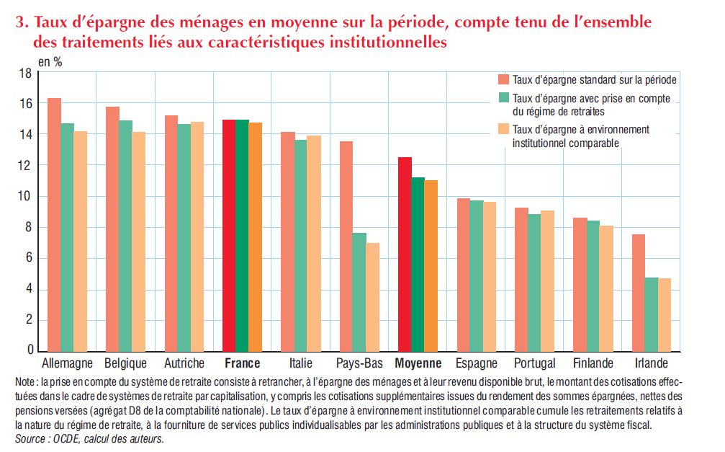
5
Source : Galiana et al. (2017)

Slide 6
Public pension expenditures – observed and projected (COR, 2017)
14,5 %
11,7 %
6

Slide 7
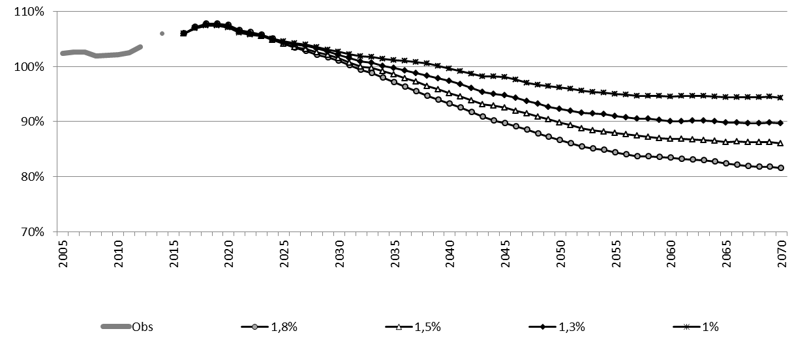
Relative standard of living (retirees/total population) – observed and projected (COR, 2017)
94 %
82%
7

Slide 8
Average pension (total retirees) / average gross income – observed and projected
42%
34%
8

Slide 9
Why do we need incentivising retirement savings?
Macroeconomic, paternalistic and redistributive arguments
Lack of national long term savings
Shortsightedness (time preference, biased expectations, assessment of future consequences of present decisions, imperfect information and difficulties to understand it even if perfect)
When PAYG pension system
is weak: ex ante incentives to circumvent ex post at-risk-of-poverty for the elderly; moral hazard of ex post intervention and adverse selection on the market for annuities
is generous: debate on the trade off between direct and differed earnings (employer’s matching up of employees’ contributions)

Slide 10
Fiscal incentives to retirement savings
Taxing retirement savings
Phasing
Entry (contributions), accumulation phase (investment earnings), exit (annuity or lump sum)
Possibilities
E (exemption) or T (taxation); with qualifications “e” (partial exemption) or “t” (partial taxation)
Two main taxing patterns: taxing upfront vs. in retirement
TEE or TTE: upfront taxation (contributions only or contributions + returns on investment) and exemption in retirement→ taxing pattern for ‘normal’ savings
EET or ETT: upfront exemption and taxation at exit (withdrawals or withdrawals and returns on investment) → taxing pattern for retirement savings; incentive: time preference and lower expected earnings at retirement + progressive taxation (even if actuarial neutrality)
10

Slide 11
Fiscal patterns of retirement savings in OECD countries
EET
EEE
Canada, Chile, Croatia, Estonia, Finland, Germany, Greece, Iceland, Ireland, Japan, Latvia, Netherlands, Norway, Poland, Romania, Slovenia, Spain, Switzerland, United Kingdom, United States
TET
Bulgaria, Slovak Republic
Austria, Belgium, France, Israel, Korea, Malta, Portugal
ETE
Cyprus
TTE
TEE
Australia, New Zealand, Turkey
ETT
Czech Republic, Hungary, Lithuania, Luxembourg, Mexico
Denmark, Italy, Sweden
Source: OECD (2016)
11

Slide 12
Taxation of retirement savings in France
Dispositif | Cotisations | Revenus des placements | Prestations
Contrat « Article 39 » (EET) | E (IR, CSG & CRDS) | E (IR, CSG & CRDS) | T (IR, CSG & CRDS + taxe à la charge de l’employeur)
Contrat « Article 83 » et plan d’épargne retraite d’entreprise (PERE) (tET) | Obligatoires : E (IR si cotisations < 8 % du salaire brut) Facultatifs : E (IR si cotisations < 10 % du revenu brut) ; T (CSG et CRDS) | E (IR, CSG et CRDS) | T (IR, CSG et CRDS)
Plan d’épargne retraite populaire (PERP), PREFON, COREM (tET) | E (IR si cotisations < 10 % du revenu brut) T (CSG et CRDS) | E (IR, CSG et CRDS) | T (IR, CSG et CRDS)
Contrat « Madelin » ou « Madelin agricole » (tET) | E (BIC, BNC) T (CSG et CRDS) | E (IR, CSG et CRDS) | T (IR, CSG et CRDS)
Plan d’épargne retraite collectif (PERCO) (ttt) | Employé (versements volontaires) : T (IR, CSG et CRDS) ; Employé (sommes issues de la participation et de l’intéressement) : E (IR, CSG et CRDS) Employeur : E (IR) ; T (CSG et CRDS) | T (CSG et CRDS lors du retrait) | E (IR pour retrait en capital) T (IR pour retrait en rente)
12
Source: COR (2018)

Slide 13
Are tax and financial incentives efficient?
Financial incentives: matching contributions by employers, State subsidies, tax credit
What impact on retirement savings?
Increase in participation
Increase in average contributions to retirement savings plans, especially for high-income individuals (and EET pattern)
Is it net savings or reallocation of existing savings? Difficult to assess (new savings between 9% and 100%, plausibly around 25%)
What cost for public finance?
Ongoing assessment at OECD
In France : 11.3 Bn€ in 2013 (to compare to 220 Bn€ overall capital income)
Trade off between subsidizing retirement savings and sustaining PAYG
13

Slide 14
Nudges and other non-financial incentives
Automatic enrollment and default options
Automatic enrollment: default enrollment of employees with a withdraw option; effective to increase participation but not necessarily the amount of contribution (US, UK)
Other default options: escalating contributions rates linked to pay raises (SMaRT program); asset allocation (PERCO in France); Swedish PPM
Information campaigns and comparators
German experiment of Riester plans: sending an information letter has lead to an estimated increase of 10% in Riester savings
Chilean experiment of a public platform comparing pay-out options: orientates savers towards the best offer and raises annuity rates
14
Notes:
Préférence pour le présent ; procrastination ; information imparfaite

Slide 15
References (selection)
Blanchet, T., Y. Dubois, A.Marino et M. Roger (2016), « Patrimoine privé et retraite en France », Revue française d’économie, XXXI(1), 207-244.
Conseil d’orientation des retraites (2018b) “Note de présentation générale”, note du secrétariat général, séance du 24 janvier 2018, 12 p.
Conseil d’orientation des retraites (2018b) “Les incitations à l’épargne retraite”, note du secrétariat général, séance du 24 janvier 2018, 15 p.
Galiana L., Lafféter Q. et O. Simon (2017), L’économie française, INSEE Références, édition 2017, p. 97-114.
OECD (2016), “Does the Tax Treatment of Retirement Savings Provide an Advantage when People Save for Retirement?” Pension Outlook 2016, chapter 2, 43-76.
OECD (2015), “Stocktaking of the Tax Treatment of Funded Private Pension Plans in OECD Countries”, Secretary-General, OECD.
Thaler, R. & S. Benartzi (2004), “Save More Tomorrow ™ : Using Behavioral Economics to Increase Employee Saving”, Journal of Political Economy, 112(1), S164-S167.
15
Notes:
Préférence pour le présent ; procrastination ; information imparfaite

Slide 16
Merci de votre attention Thanks for your attention
Suivez l’actualité et les travaux du COR sur www.cor-retraites.fr et twitter @COR_Retraites

